Slide 1
Food for good
Guided by:
Professor. Gail raynus
Presented by:
Letitia D’Souza
Noopur Kamble
Taj Poovaiah Palecanda
Preet Parmar
Shruti Singhal

Slide 2
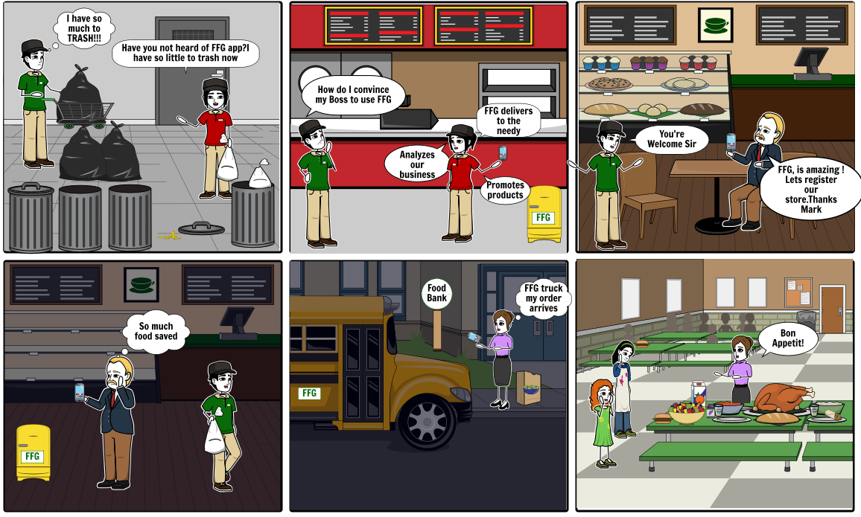
HERE’S A STORY FOR YOU!

Slide 3
The big problem
FOOD WASTAGE
Generates 3.3 billion tonnes of greenhouse gases
Poor nutrition causes nearly 45% of deaths in children under five
About 40 million tonnes of food wasted in US
Uses about 1.4 billion hectares of land – 28 per cent of the world’s agricultural area
IRRIGATION water used would be enough for domestic needs (at 200 litres per person per day) of 9 billion people

Slide 4


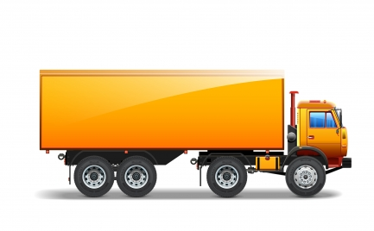

Our solution to the world’s problem
SUPPLIER
CONSUMER

Slide 5

What’s awesome about us?
Consumers & Suppliers can track the Order process simply using the app
Can handle multiple restaurant requests at the same time using storage units
Perishable food could last longer in the storage units till the delivery truck arrives
A door-to-door delivery and pick-up of food
Label Printing options for categorizing food with expiry information ensuring optimal food quality
Supplier benefits by Digital Marketing for promotion of new products
Business Analytics for the Supplier’s inventory
Tech support teams to handle issues raised by App users

Slide 6
Who uses our app?
Supplier
Supplies the left over food to avoid wastage and help the needy
Driver
Responsible for transporting food from suppliers to consumers
Customer
Utilizes the left-over food by helping the needy and hungry
Tech Support
Manages user and order complaints to increase customer satisfaction

Slide 7
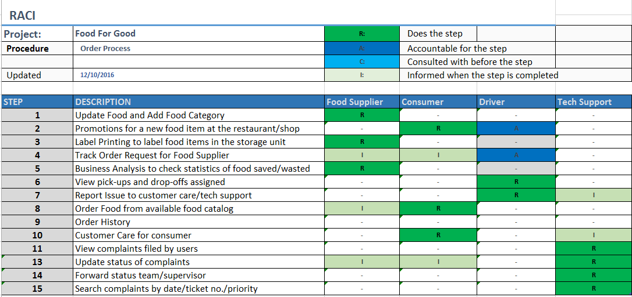
USER ROLES & RESPONSIBILITIES

Slide 8
USER Requirements
Supplier
Should be able to log food availability
Driver
Tech Support
Should be able to view user issues
Should be able to update ticket status – Pending or Completed
Should be able to register for the promotion plan
Consumer
Should be able to view food that is available for donation
Should be able to place and track the food request
Should be able to confirm correct delivery of order and report incorrect order
Should be able to view his daily pick-up and delivery tasks
Should be able to get e-sign from customer on correct delivery
Should be able to generate tickets for the issues and prioritize them
Should be able to update his task status and report any issue

Slide 9
HOW DOES OUR APP WORK?

Slide 10
Here are the important links:
Food For Good - UI Prototype
User Personas
Windows Navigation Diagram
Use Case Diagram
Activity Diagram
Business Process Model

Slide 11
FEEL FREE TO ASK US QUESTIONS!
THANK YOU

